Slide 1

Talent Development Program
Module 3 : Data Warehouse
Session 5: Advanced Dimensions
Notes:
This template can be used as a starter file for presenting training materials in a group setting.
Sections
Right-click on a slide to add sections. Sections can help to organize your slides or facilitate collaboration between multiple authors.
Notes
Use the Notes section for delivery notes or to provide additional details for the audience. View these notes in Presentation View during your presentation.
Keep in mind the font size (important for accessibility, visibility, videotaping, and online production)
Coordinated colors
Pay particular attention to the graphs, charts, and text boxes.
Consider that attendees will print in black and white or grayscale. Run a test print to make sure your colors work when printed in pure black and white and grayscale.
Graphics, tables, and graphs
Keep it simple: If possible, use consistent, non-distracting styles and colors.
Label all graphs and tables.

Slide 2
Session Overview
1
2
Advanced Dimensions
3
When to Use
Review Dimensions
Notes:
This is another option for an Overview slide.

Slide 3

Learning Objectives
Explain what a Dimension table is and how it works in a DW
Explain the different types of dimensions we have and how they each work
Notes:
What will the audience be able to do after this training is complete? Briefly describe each objective how the audience will benefit from this presentation.

Slide 4
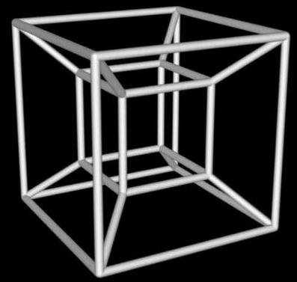
Why is a Dimension Table?
A dimension table is unique to data warehouses
Used to hold descriptive or textual informative data
Does not mean there is ONLY characters, can also be numeric of used for description

Slide 5
Advanced Dimensions
Conformed Dimension
Junk Dimension
A conformed dimension is a dimension that is referenced in by many Fact tables
In each Fact table, the Dimension provides the exact same data or purpose
Conformed dimensions can also be when two dimensions match each other exactly or are perfect subsets
A junk dimension is a handy grouping of data this is not necessarily used in any analysis
Data used such as flags or markers must still be used in a data warehouse to help identify some information, but it may not necessarily have anything to do with the measurements
Examples included True, False, and other comments

Slide 6
Advanced Dimensions
Degenerate Dimension
Role-Playing Dimension
A degenerate dimension is a key used typically in a dimensions, but lacks significant attributes
Degenerate dimensions are often put into Fact tables, since they have little to contribute
Often times play a role in identifying different fact values
Receipt ID & Transaction ID
Role playing dimensions are used to have a single dimension serve multiple roles when a Fact table(s) are referencing it
A Fact table can reference the dimensions in one instance and have a specific meaning, and then reference the same table again but this time have new meaning or data to use

Slide 7
Advanced Dimensions
Rapidly Changing
Rapidly Growing
A Rapidly Changing dimension is a dimensions who’s data values constantly change
In a table where only single values are stored, these values will constantly change as time goes on
In a table where all records are kept, these values will each be recorded as new rows
A dimensions whose values or rows increase exponentially
Rows are inserted on a constantly high rate from the data it’s monitoring, causing the table to expand very fast
History of stock market prices, history of gas prices internationally, etc.

Slide 8
Advanced Dimensions
Slowly Changing Dimensions
Type 0
Data that never changes and should not be changed
Type 1
Data the does change, but only the most recent value is shown
Type 2
Data changes, and now all changes or modifications are recorded
Type 3
Data changes, is recorded, but now we only record up to a certain number of records
Type 4
Uses two tables, one being a history table
Recent values in one table, while historical in another
Type 6
Combination of features from types 1, 2, and 3
1+2+3=6

Slide 9
Questions?
Notes:
Is your presentation as crisp as possible? Consider moving extra content to the appendix.
Use appendix slides to store content that you might want to refer to during the Question slide or that may be useful for attendees to investigate deeper in the future.

Slide 10

Summary
Discuss the different types of Dimensions that can be used in a Data Warehouse
Explain the importance of having these different dimensions
Explain the different types of data in SCD’s
Notes:
Summarize presentation content by restating the important points from the lessons.
What do you want the audience to remember when they leave your presentation?
Save your presentation to a video for easy distribution (To create a video, click the File tab, and then click Share. Under File Types, click Create a Video.)

Slide 11
Thank You
Notes:
Is your presentation as crisp as possible? Consider moving extra content to the appendix.
Use appendix slides to store content that you might want to refer to during the Question slide or that may be useful for attendees to investigate deeper in the future.

